Slide 1
Personnel Security Update January 2016
Presented by:
Personnel Security Management Office for Industry (PSMO-I)

Slide 2
National Industrial Security Program
“…the National Industrial Security Program shall serve as a single, integrated, cohesive industrial security program to protect classified information and to preserve our Nation's economic and technological interests.”
Executive Order 12829 of January 8, 1993
DSS is addressing today’s risk environment … through our authorities and our unique access to industry

Slide 3
DSS Top Priorities
People First, Mission Always
Partnership With Industry & Government
Tell the DSS Story
3

Slide 4
Influencing the Way Ahead
WNY Implementation
DoD Programs
Insider Threat – DoD Insider Threat Management and Analysis Center (DITMAC) - new DSS mission
National Level Programs
Federal Investigative Standards (FIS)
Tier 3 Secret/Tier 5 Top Secret
Performance Accountability Council (OMB PAC PMO)
Personnel Security Reform 120 Day Report to the President - (Performance.gov)
90 day Review (Cyber Breach)
Innovations
PSI-I
Click to Sign
Interim Clearance automation
Industry Portal for information update, document sharing, and SF312
Information Systems
Congressional
Section 1628 of NDAA FY15 Personnel Security and Insider Threat
Page 870 (CE, Automated Records Checks, Insider Threat Analysis)
Defense Information System for Security (DISS) - JVS
National Industrial Security System (NISS) replace ISFD and eFCL
National Contract Classification System (NCCS) – DD Form 254

Slide 5
Functions of the PSMO-I
PCL
Oversight
Triage Outreach Program
e-QIP submissions
NISP PCL IT System Rqmts
e-Fingerprints
centralized communication
Industry Liaison
Personnel Clearance
Processing
increased visibility
efficiency
PSMO-I
Clearance System Records Data Management
systematic vision
timeliness
Interim Clearances
Non-disclosure Agreement (SF-312)
collaborative effort
streamlined processes
PCL Eligibility/Access
Interim Suspension
Continuous Evaluation
Incident
Report
Triage
Periodic
Reinvestigations

Slide 6
NISP PCL Report Card Dec 2015
On the Radar | Description | Status
CR | Funding | ~250M
 | Eligible | ~940K
 | Access | ~860K
 | e-QIP Submissions | ~220K
Aging | Interim Clearances | ~80K
Triage | Incident Reports (open) | ~6K*
DQI | Overdue PR (In Access) | ~8K
DQI | Overdue PR (NOT In Access) | ~11K
 | Electronic Fingerprint | 97%
 | RRU | Closed within 2 days
Values represented are on an annual basis unless indicated by “*” to depict the monthly value.

Slide 7
Incident Reporting Dec 2015

Slide 8
Facility Security Officer (FSO) Role
Responsible for the day-to-day PSI program management for your facility
Trained to comply w/NISPOM requirements to obtain/maintain security clearances
Initiate/submit completed e-QIP (SF-86) to PSMO-I based on contract requirements
Submit signed Non-Disclosure Agreement (SF312) to PSMO-I
JPAS record maintenance/update:
Take owning or servicing relationship
Add or remove Access as required
Add separation date as appropriate
Ensure Continuous Evaluation (CE)
Track and Initiate Periodic Reinvestigations
Report Incidents, security violations, suspicious contact reports
Conduct Security Training
Maintaining SF86 - No Longer cited as Vulnerability
No JPAS and SWFT Inactive Accounts
No JPAS Printouts (No Sharing)
No Looking Up Your Own Record
No Unreported Incident Reports
No Overdue PRs
No Unacceptable Notices (e-QIP)
Complete annual PSI-I survey to project requirements for the next 1 – 3 years

Slide 9
FSO Effectiveness
SVA
28% findings PCL related
Manage your JPAS records - 14% related to JPAS maintenance
Avoid Red Flag: Ensure no KMP overdue PRs
Goal: No Overdue PRs – can submit up to 90 days in advance
Avoid Red Flag: Keep JPAS account active - Log in daily
JPAS Account Inactive/Terminated –30 days/45 days
SVA
CE
KMP
KMP
Ensure KMP PCL at level of FCL
Notify IS Rep of KMP changes
PSI Initiation
PSI Initiation
Keep PSI requests to a minimum
Submit e-QIP as soon as completed - IRTPA initiate timelines
Submit electronic fingerprints when submitting e-QIP
CE
Security Training on Self Reporting and Submitting Incident Reports

Slide 10
OPM Cybersecurity Breach
OPM started sending notification letters and PIN codes out to individuals who's Social Security Number and other personal information was stolen in a cyber intrusion involving background investigation records.
Notification process is expected to take up to 3 months
https://www.opm.gov/cybersecurity
Posted on OPM site: "While we are not aware of any misuse of your information, we are offering you, and any of your dependent minor children who were under the age of 18 as of July 1, 2015, credit and identity monitoring, identity theft insurance, and identity restoration services for the next three years through ID Experts, a company that specializes in identity theft protection.“
List of Names and Address (no longer required)
Obtained through Third Party Vendor
Thanks to Industry Companies for providing

Slide 11
Tier 3/3R Implementation
Source: DMDC Webinar, October 2015

Slide 12
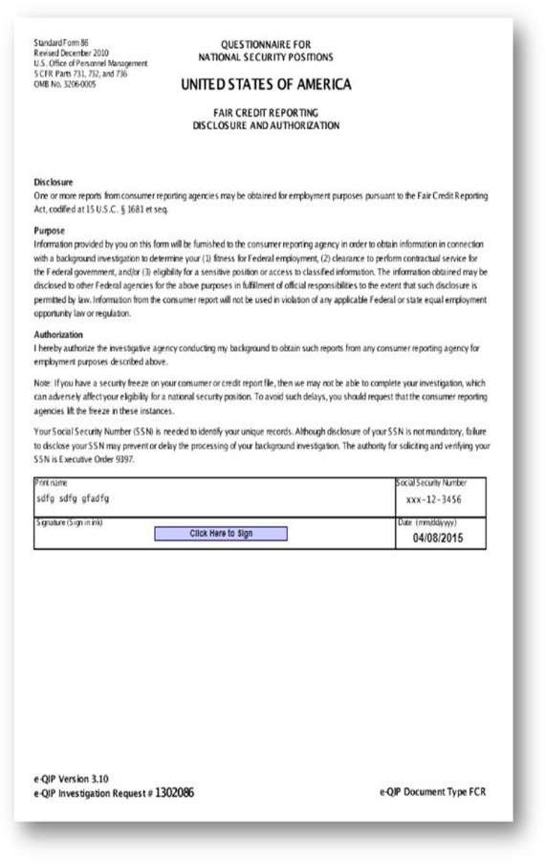
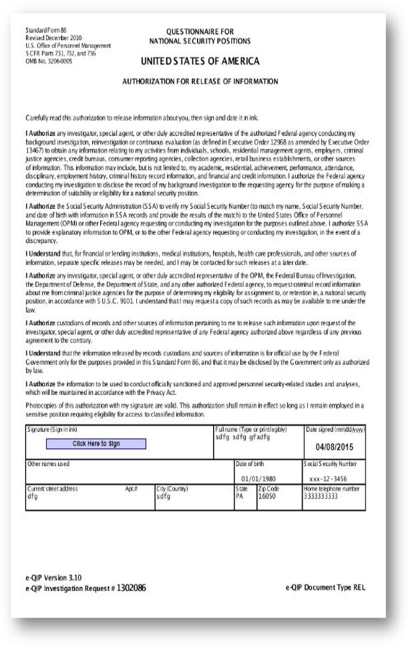
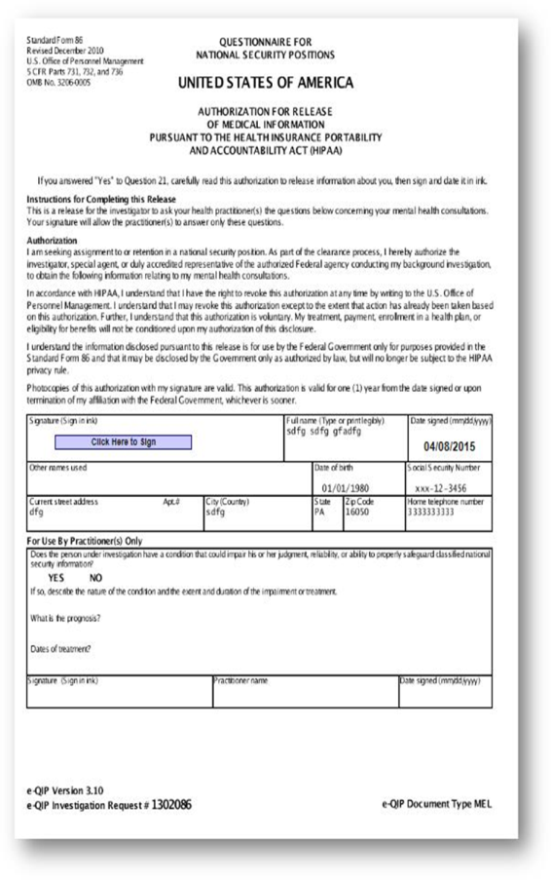
Click to Sign (e-QIP)

Slide 13
Click to Sign (e-QIP and JPAS)
Remain the same…
Eliminate…
User ID & password login capability (No PKI Cert required)
Filling out the SF-86
FSO and Subject can print and save SF86 and Signature Pages
Submitting the SF-86 to FSO and PSMO-I
Printing and Signing
Scan, Mail, Fax, Upload
OPM Rejects:
Wrong date (format)
Signatures outside the line or unreadable

Slide 14
For Further Assistance…
PSMO-I
Address: Defense Security Service
ATTN: PSMO-I
7556 Teague Road, Suite 500
Hanover, MD 21076
Fax: (571) 305-6011 ∙ PSMO-I.fax@dss.mil*
Email: AskPSMO-I@dss.mil ∙ Policy_HQ@dss.mil
*Note: When using the e-fax option to submit SF-312s or any PII, encrypt the file in the first email and send the password in a separate email.
DoD Security Services Call Center
Phone: (888) 282-7682
Menu Options:
1 – OBMS/e-QIP/STEPP/ISFD/NCAISS Account Lockout or Password Reset
2 – Personnel or Facility Security Clearance Inquiries
3 – OBMS | 6 – ISFD
4 – e-QIP | 7 – NCAISS
5 – STEPP | 8 – General Inquiry
DMDC Contact Center
Phone: 1-800-467-5526
Email: dmdc.contactcenter@mail.mil ∙ dmdc.swft@mail.mil
Menu Options:
1 – JPAS | 5 – Personnel Security Inquiry
3 – SWFT 4 – DCII | 6 – General Inquiry / Contact Center Information
DoD CAF Call Center
Phone: 301-833-3850 (SSOs and FSOs ONLY)
Website: http://www.dodcaf.whs.mil/
Menu Options: 5 – Industry
DOHA
Phone: 866-231-3153
Email: dohastatus@osdgc.osd.mil

Slide 15
Modes of Communication
JPAS PMO Meetings
Briefings to Industry
AskPSMO-I Webinar
CDSE Flash Email
DSS Facebook
CDSE Webinar
DSS/IO Bulk Email
DSS.MIL
NCMS Meetings
Voice Of Industry
NCMS Facebook
JPAS Website
DSS Twitter
INSA
Triage Outreach Program
DMDC PSA
NISPPAC
AskPSMO-I
Access Magazine
ISAC
DMDC Contact Center
SWFT
DoD CAF Call Center
DoD Security Services Call Center
JPAS
ISFD

Slide 16
For additional assistance see Contact Information on the next slide…

